Slide 1

2025/2/28
Reinforcement Learning with Augmented Data
Feng Jiang
Notes:
Introduce the topic of reinforcement learning and its relation to data augmentation.
Briefly mention how the paper combines these two techniques for improved results.

Slide 2
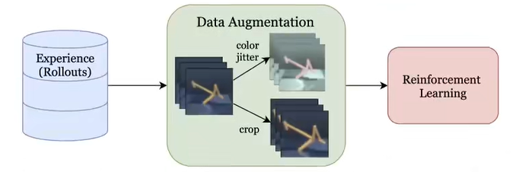
Introduction
Reinforcement Learning (RL)
An agent learns to optimize actions in an environment through trial and error.
Data Augmentation
A technique used in supervised learning to improve model robustness by generating new data variations.
Notes:
Reinforcement learning is basically where an agent is has to learn to solve and optimize problem by repeatedly interacting with the ward. You can see here for example , here is a walker with two foot and basically needs to stand upright and walk for a number of steps， the further it goes， the better. So by repeatedly trying this and getting better and better and that is reinforcement learning.
The second part is the data augmentation. Data augmentation is a technique used in supervised learning , what does it mean? So for example if u have a task for an image classification, here is a picture of cat with label cat. You can feed that through your neural network. And you have a database with 1 million images. Usually what people do is they go 20 or 50 times through that database basically have the model learned from each of the time. But what turns out be more successful is if you do data augmentation. That means you have a in between layer that takes this image and modified it in some small way. This could be, for example , it blocks part of this image, and you feed that through the model, the next time the image comes up, it does something different. It randomly crops the image to only top right part. And the next time it does a bit of a color jitter, and next time it goes grayscale. And so supervised learning has found data augmentation to be quit beneficial, so not only do you make the model learn what this original picture is but you also make the model kind of learn some small variations of that picture you can be pretty sure that they would not change the label, so to improve model robustness by generating new data variations..
So this paper is basically claims if you want to do reinforcement learning, if you simply do data augmentation with the input data, it works much much much better.

Slide 3
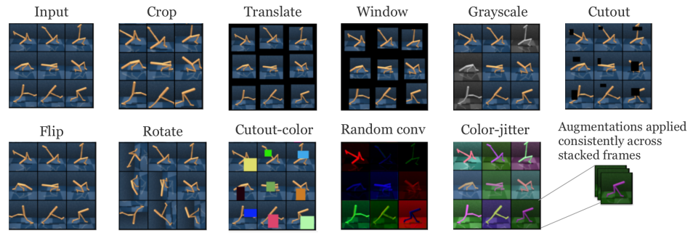
Data Augmentation Techniques
Notes:
Lets dive into it. This paper proposes just plug in the data augmentation and then do reinforcement learning on the augmented data. They use these data augmentations: so crop as what we just discussed is a random crop. grayscale means that the picture goes to gray black and white with a certain probability . Cut out means there is a little parts missing .Cutout color the same but in a random color. Flip means the image horizontally or vertically according to a random probability. Rotate is the same but you instead of flip you rotate it. Random conv means you randomly convolve it with a filter , in this case some red or blue or yellow filter. Color jitter means you can jitter around the color in a sort of way that doesn’t mess up too much. So it basically kind of just change the color or something but the overall image still looks the same. The only thing you have to pay attention to is that in your reinforcement learning pipeline ,if you have a walker like this. You don’t want to take this one current observation in here but sometimes you want to take kind of the stacked of the last few frames so that the model kind of gets an idea what happened during the last one second. For example in this walker it’s not only important where the legs are but also how they are moving. They say the most important thing here is that these augmentations are applied consistently across the stacked frames . So basically you select on an augmentation and then you apply it to these stacks frames all the same and then in the next pass you have a different set of stacked frames then you can decide on a different augmentations.

Slide 4

Implementation and Methodology
Proximal policy optimization.
PPO is a state-of-the-art on-policy algorithm for learning a continuous or discrete control policy, (ao). PPO forms policy gradients using action-advantages, At = A(at st) = Q(at st) V (st), and minimizes a clipped-ratio loss over minibatches of recent experience (collected under old ):
State-Value Estimator
Our PPO agents learn a state-value estimator, V (s), which is regressed against a target of discounted returns and used with Generalized Advantage Estimation [4]
Notes:
其中，ρt(θ)\rho_t(\theta)ρt​(θ) 是当前策略与旧策略的比值，它描述了新的策略相对于旧策略的概率变化：A_t 是优势函数（advantage function），表示某个动作相对于当前状态的优越性。如果某个动作的优势较高，说明这个动作是更好的选择。Clip操作：通过“clip”函数，PPO限制了策略更新的幅度状态值函数 Vϕ(s)V_\phi(s)Vϕ​(s) 用于估计在某一状态下代理所能获得的未来奖励的期望值。Vϕ(ot)V_\phi(o_t)Vϕ​(ot​) 是由代理通过当前策略学习到的状态值估计。目标值 VttargetV^\text{target}_tVttarget​ 是实际计算得到的目标值，通常通过折扣回报来计算，即考虑到从当前状态开始的未来奖励，防止了策略更新过大。通过限制，模型只会在策略变化在一个小范围内进行更新，这有助于保持稳定的学习过程。

Slide 5
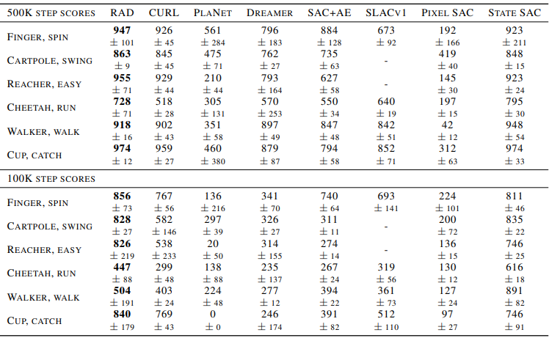
Results and Performance
Table 1: We report scores for RAD and baseline methods on DMControl100k and DMControl500k. In both settings, RAD achieves state-of-the-art performance on all (6 out of 6) environments. We selected these 6 environments for benchmarking due to availability of baseline performance data from CURL , PlaNet , Dreamer , SAC+AE , and SLAC .
Notes:
So as I say they drop the things here and the results show that it significantly outperforms many existing baselines. CURL, Dreamer, and Planet—each of which also employs pre-training or augmentation techniques. It is important to note here that this is on 1100k and 1500k DM Control which means that there is a limit on the number of the frames from these control tasks you get. So the difficulty is learning from limited data.

Slide 6
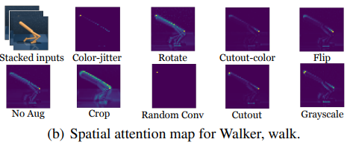
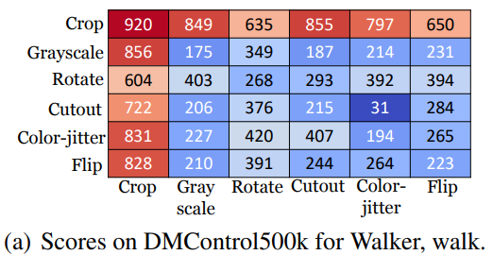
Attention Maps
Which data augmentations are the most effective?
Figure (a), indicate that most data augmentations improve the performance of the base policy, and that random crop by itself was the most effective by a large margin.
Notes:
The table here just basically combine two augmentations , this means you plug rotate with grayscale , and that gets you to 300 points in this walker and if you plug crop with crop then it gets 900 points. And it turns out random crop is the most effective.
And you can see when there is no data augmentation it focuses on no points, but when you do crop it focuses on this ridge here which makes sense because that’s the thing needs to be vertical in order to make the walker to be stable .And you can see it focuses on different thing and the crop method make the model focus on the most important part of the image

Slide 7
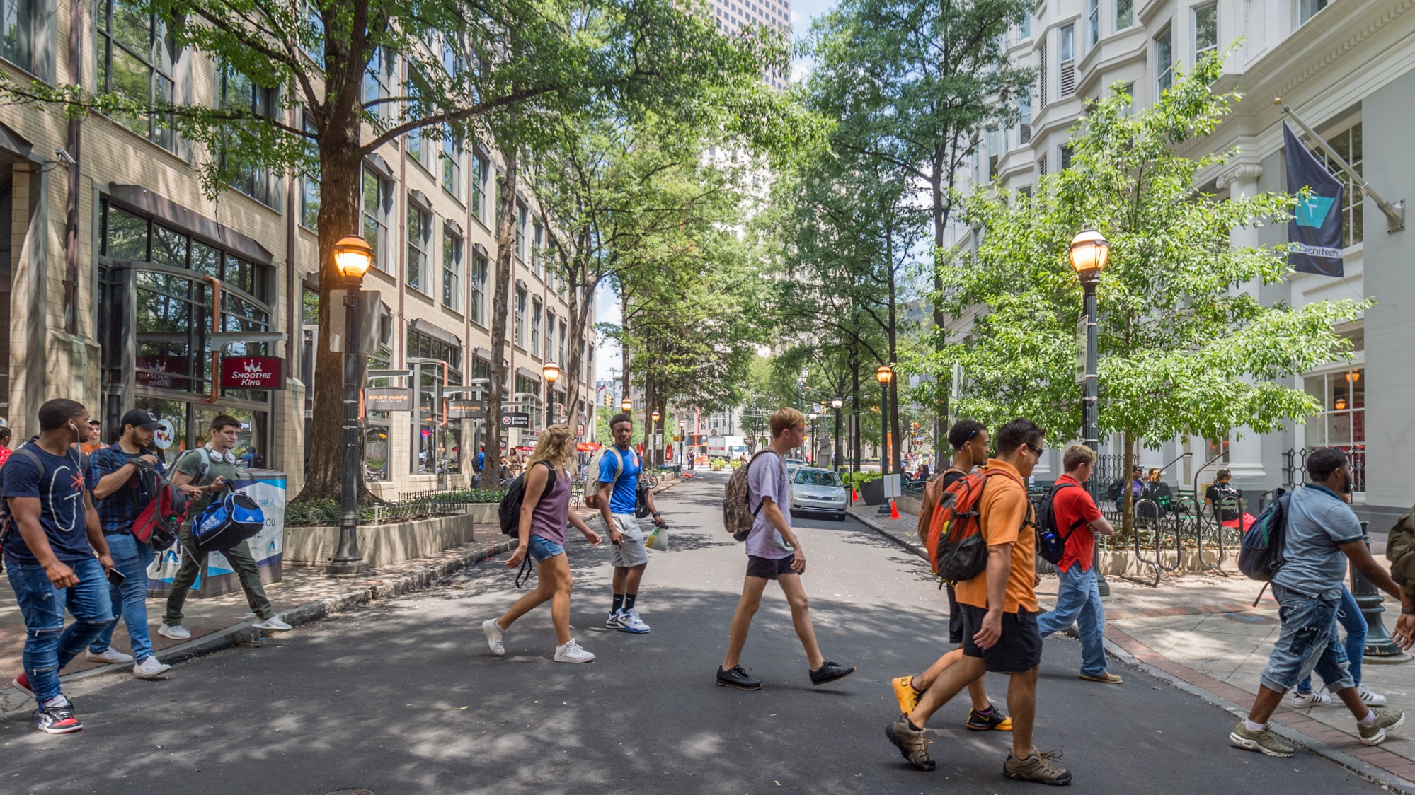

Conclusion
Integration of Data Augmentation and RL
Enhanced Robustness and Generalization
Effective in Limited Data Environments
Future Potential
Notes:
In conclusion, this paper demonstrates that integrating data augmentation techniques into reinforcement learning significantly enhances the agent’s ability to learn, generalize, and adapt to diverse environments. By applying augmentations we not only improve the robustness of the model but also help it focus on key features that are critical for decision-making.
‘This approach is particularly valuable when working with limited data or in environments where variability is high. By diversifying the training experience, we enable the model to handle unseen scenarios more effectively, making it a promising strategy for improving RL in real-world applications.

